Slide 1


Smart IoT Dustbin
Group Coursework Presentation Slide
CC5068NI - Cloud Computing and the Internet of Things
Section: L2N2
Team: 1
London Met ID | Student Name
21040607 | Kamana Thapa
22015861 | Roshan Kumar Mandal
21040603 | Aryan Shrestha
21040632 | Swikriti Timilsena
21040630 | Somia Dahal

Slide 2
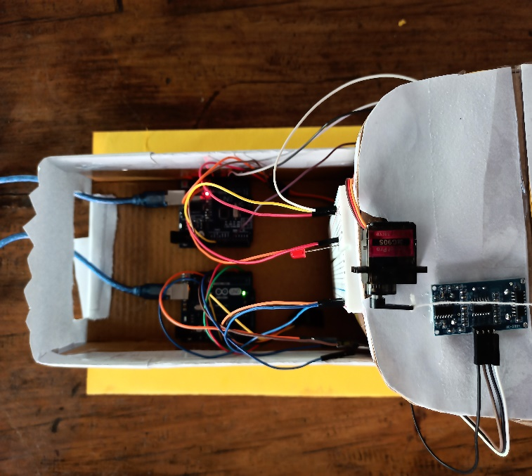
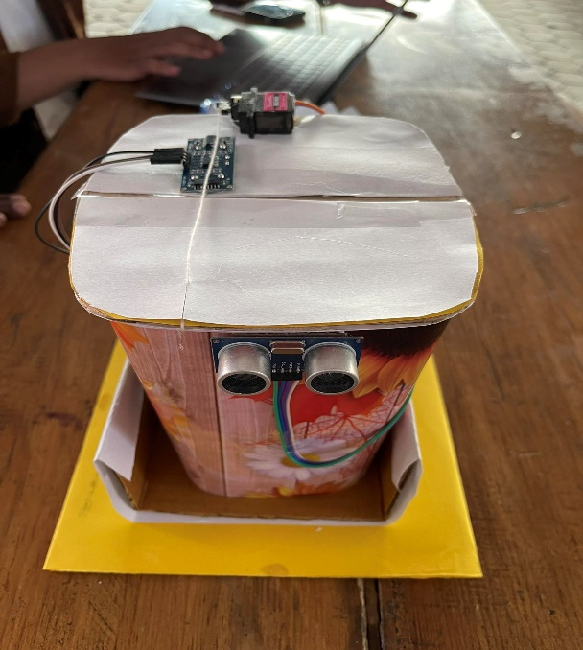
Introduction
Welcome to our presentation on the Waste Management IoT project.
Our aim is to revolutionize waste management through the integration of IoT technologies.
By leveraging sensors, cloud computing, and automation, we can create a smarter and more efficient waste management system

Slide 3
The Challenge of Waste Management
Image 2
The volume of waste produced is continuously increasing in our modern civilization.
Traditional waste management methods require manual monitoring and can lead to overflow and inefficiencies.
We need a solution that can optimize waste collection, minimize overflow, and improve resource utilization.

Slide 4
The Solution: Smart IOT Dustbin
Introducing the Smart IoT Dustbin, a game-changing solution for waste management.
These dustbins are equipped with IoT sensors and cloud computing capabilities.
They automate waste level monitoring, lid control, and data analysis, making waste management smarter and more efficient.

Slide 5
Next: Components Used
Every components used in our project

Slide 6
Components Used
Hardware
Arduino Uno(02)
Ultrasonic Sensor (HC-SR04)
Servo Motor
Breadboard
Jumper Wire
LED Light
Esp8266 Wi-Fi Module

Slide 7
Components Used
Software
Arduino IDE
Tinker Kad

Slide 8
Next: System Demonstration
Working Mechanism of out prototype

Slide 9

System Demonstration
Two Arduino UNOs:
Opens the lid
Sends the trash level data to the cloud
d

Slide 10
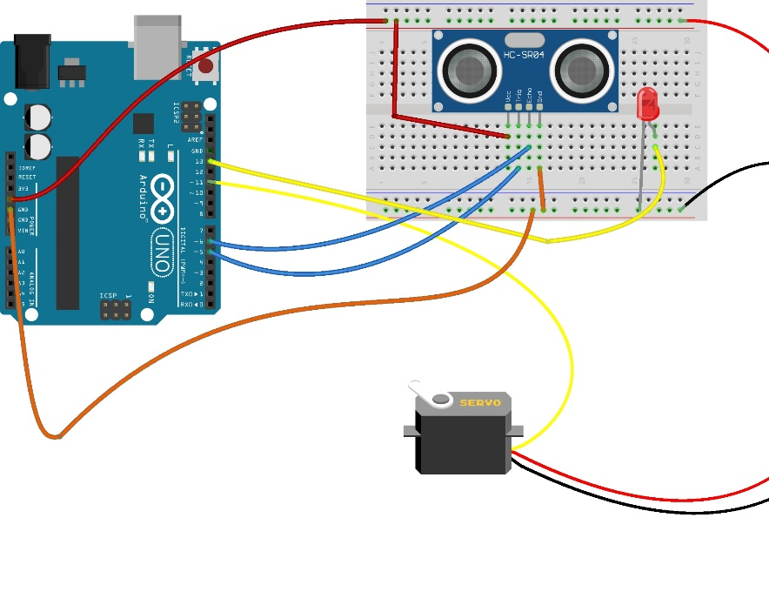

1st Arduino UNO
Communicates Servo Motor with 1st ultrasonic sensor to open the lid

Slide 11

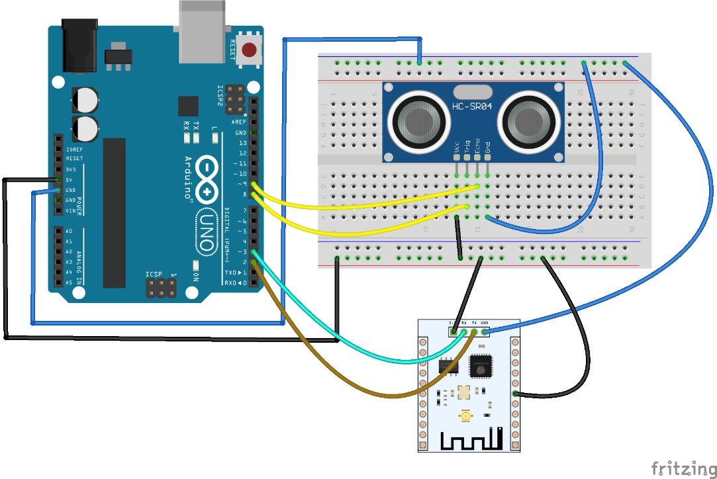
2nd Arduino UNO
Takes the input from 2nd ultrasonic sensor and sends it to the Cloud for analysis

Slide 12
Next: Benefit and Impact
Some of the benefits and impacts of our prototype

Slide 13
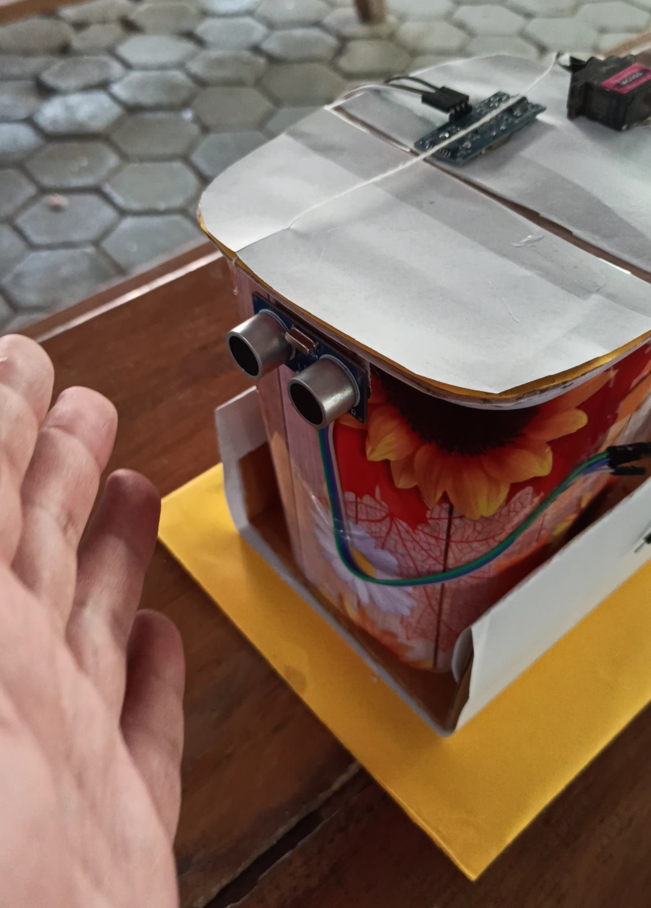
Benefits & Impact Our Product
The Smart IoT Dustbin project brings numerous benefits and has a significant impact some of them are listed below:
Reduced human intervention: The automation provided by the Smart IoT Dustbins reduces the need for manual monitoring and collection, saving time and resources.
Data-Insights: The dustbin generates the fill level which is collected in the cloud. Analysis of this data could provide useful insights into waste generation and waste management.

Slide 14
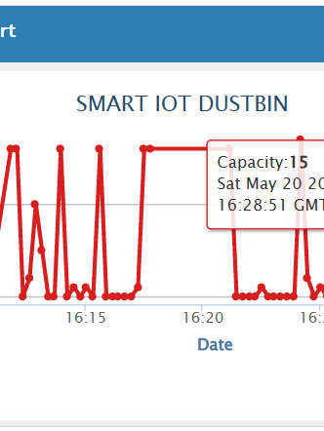
Benefits & Impact Our Product
The Smart IoT Dustbin project brings numerous benefits and has a significant impact:
Efficient waste collection: Real-time data-driven optimization of waste collection routes and schedules reduces overflow and ensures prompt waste disposal which enables waste management optimization and allows more efficient and timely collection of waste.

Slide 15

Benefits & Impact Our Product
The Smart IoT Dustbin project brings numerous benefits and has a significant impact:
Enhanced public health: By maintaining cleaner and healthier surroundings, the Smart IoT Dustbins contribute to improving public health and hygiene.

Slide 16
Benefits & Impact Our Product
The Smart IoT Dustbin project brings numerous benefits and has a significant impact:
Scalability, dependability, and cost-effectiveness: Cloud computing enables the project to scale easily, ensures data reliability, and offers cost-effective storage and analysis solutions.

Slide 17
Next: Future Works and Conclusion
How this prototype could further be improved

Slide 18
Future Possibilities
The integration of Smart IoT Dustbins with other devices and systems opens up exciting possibilities:
Sharing data with waste collection companies to optimize routes and schedules.
Providing insights to city planners for better waste management and urban planning decisions.
Continuous advancements and improvements based on data analysis and feedback.

Slide 19
Conclusion
The Waste Management IoT project presents a powerful solution for improving waste management.
By embracing IoT, sensors, and cloud computing, we can create a smarter and more sustainable future.
Let's work together to create a cleaner, greener, and healthier planet.

Slide 20
Individual Contribution (WBS)
Smart IOT Dustbin
Roshan
Aryan
Introduction
Aim & Objectives
Components Used
Swikriti
Somia
Demonstration
Benefits and Impact
Future Possibilities
Kamana
Current Scenario
Conclusion

Slide 21
Thank You

